Slide 1
Machine learning to unveil the fluid structure interaction of air-backed impact
Dynamical Systems Laboratory
New York University Tandon School of Engineering, Brooklyn, NY
Simon Carrillo Segura | Akhilesh Kapse
2 July 2021

Slide 2
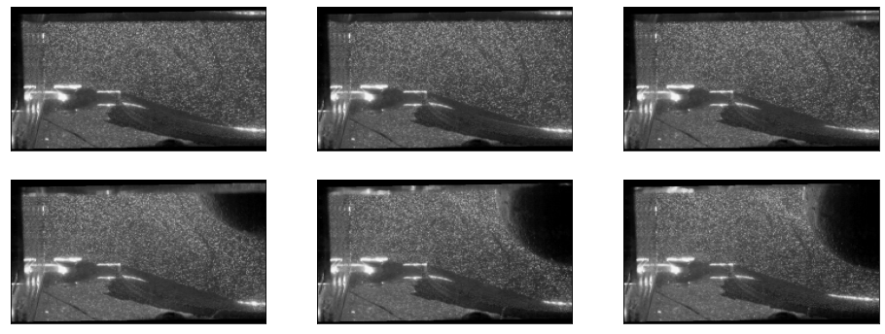
Velocity Field Data
Original image
Used PIV-LAB for velocity field predictions.
Per-Process the field in 2 channel window.
Stored the data in .npy file for easy and fast loading.

Slide 3
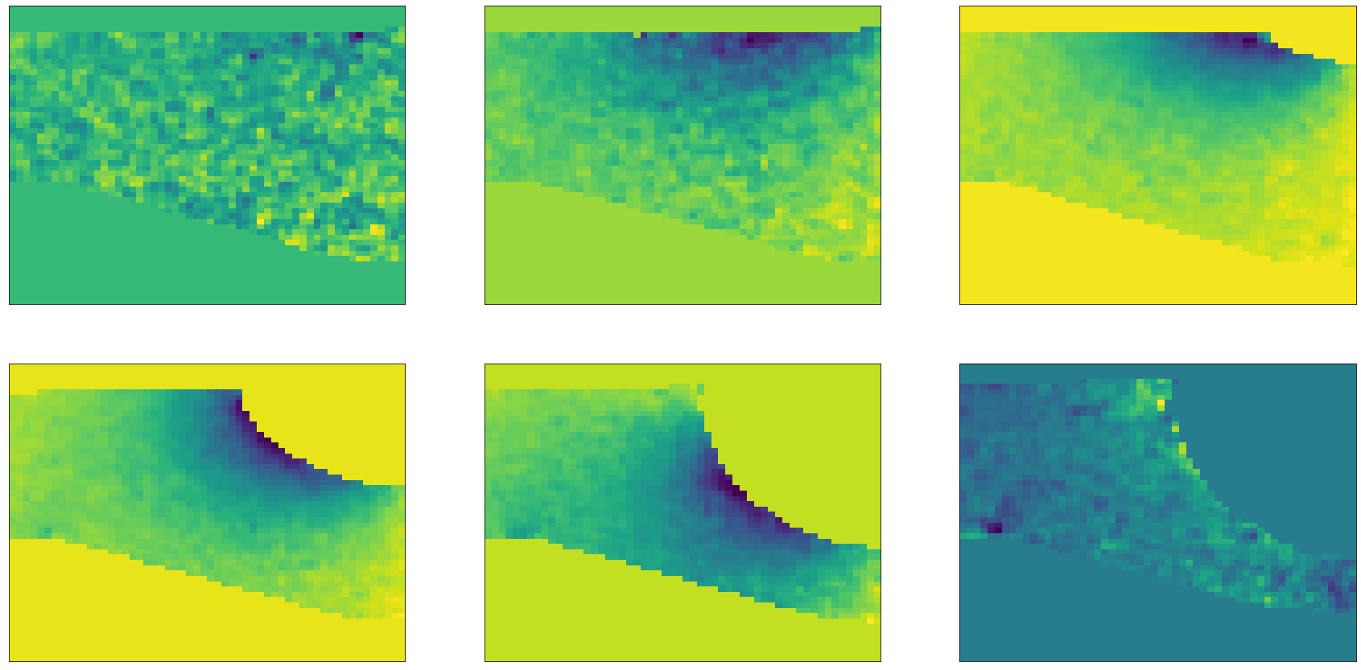
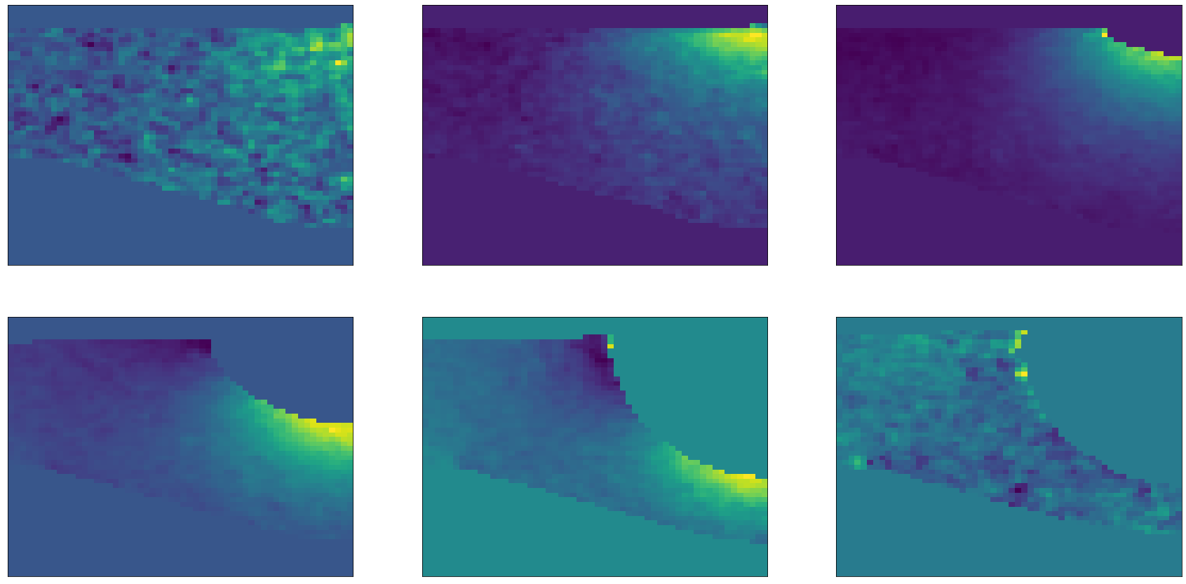
Velocity Field Data
Vector
U-component (top image)
V-component (bottom image)
Stacking them both as a ground truth data.
(i.e. 56x56x2)

Slide 4
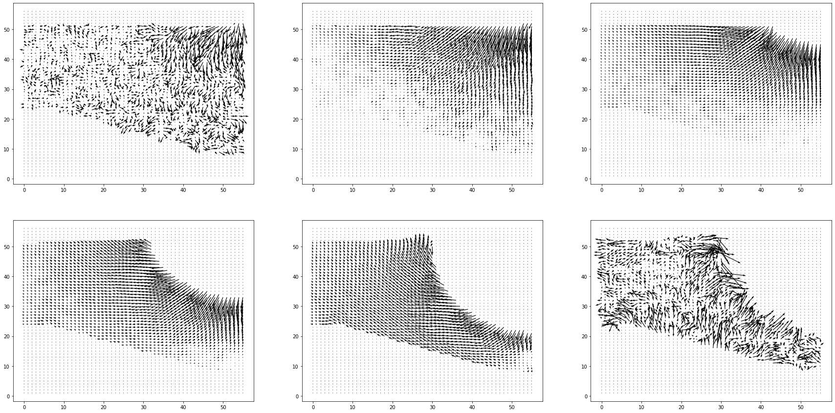
Velocity Field Data

Slide 5
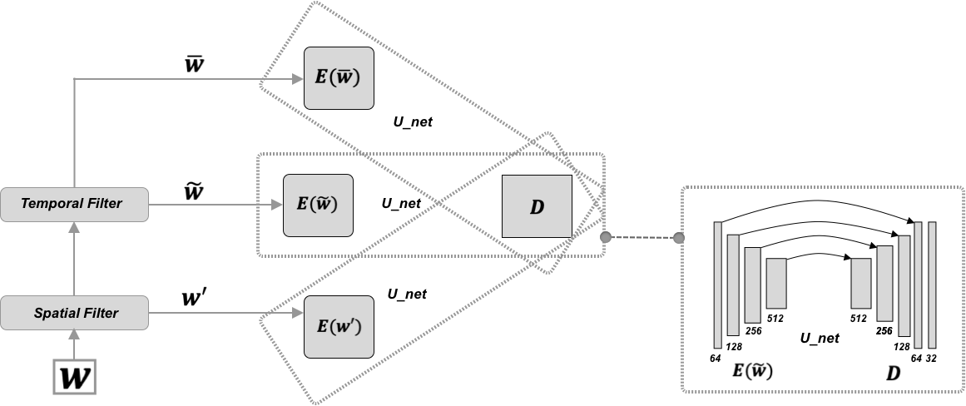
Turbulent Flow Net
● 3-Identical encoders to learn the transformations of the three components of different scales.
● One shared decoder that learns the interactions among these three components to generate the prediction.
● Using MSE loss to optimize.
https://ucsdml.github.io/jekyll/update/2020/08/23/TF-Net.html

Slide 6
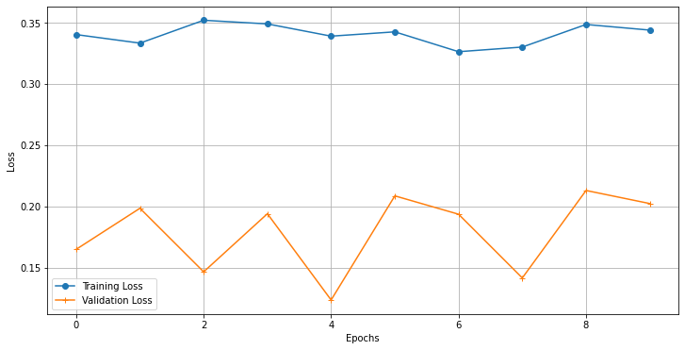
Loss
Model failing to reduce loss.
Change loss function.
Hyper-parameter tune.
Change model.
Check input data

Slide 7
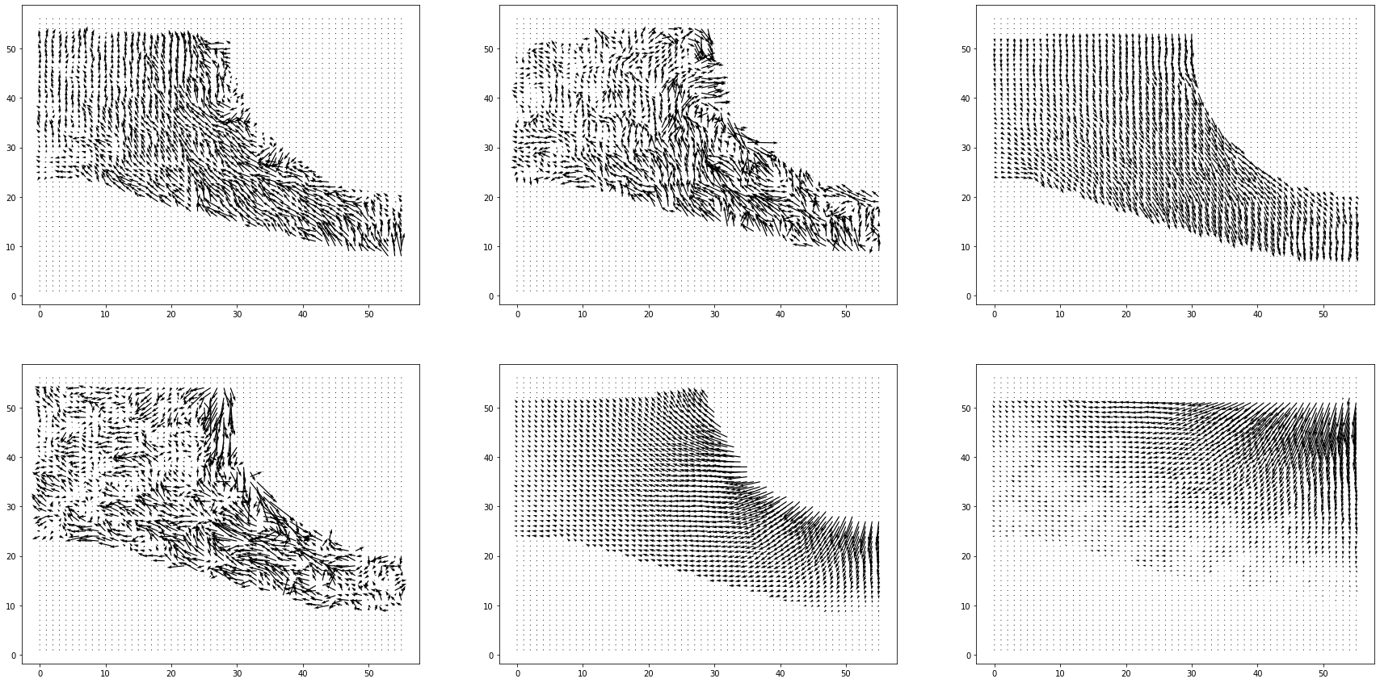
Results
Ground Truth

Slide 8
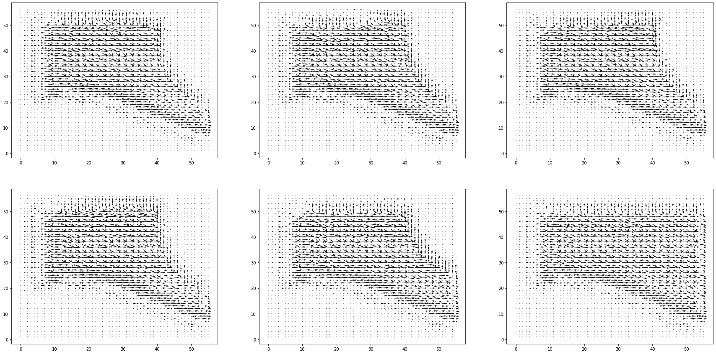
Results
Predicted

Slide 9
Thank You
Future work-
Loss Function (upgradation)
Validation and working more on PIV_LAB velocity predictions.

